Slide 1

IT Infrastructure Overview
Izhar Fuentes
Account Executive
949.735.1829
ifuentes@affirma.com

Slide 2
About Affirma

Slide 3




Company Overview
OUR MISSION
“Become the best at applying solutions and services to positively impact people.”
300+
Employees globally
98%
Dublin, Ireland
Customer Satisfaction
Bellevue, WA
Reno, NV
16
Ahmedabad, India
Los Angeles, CA
Years in business
Irvine, CA

Slide 4



Why Affirma?
Customer satisfaction
Breadth & Depth of Experience
Our CEO, executives, project managers, developers, testers, & account managers
200+ Software Services team members providing Salesforce Application Development & Integration
all have Customer Satisfaction as the #1 metric on their scorecard.
Web & Mobile Application Development, ETL Design & Development, Business Intelligence & Data Warehousing

Slide 5












Clients

Slide 6
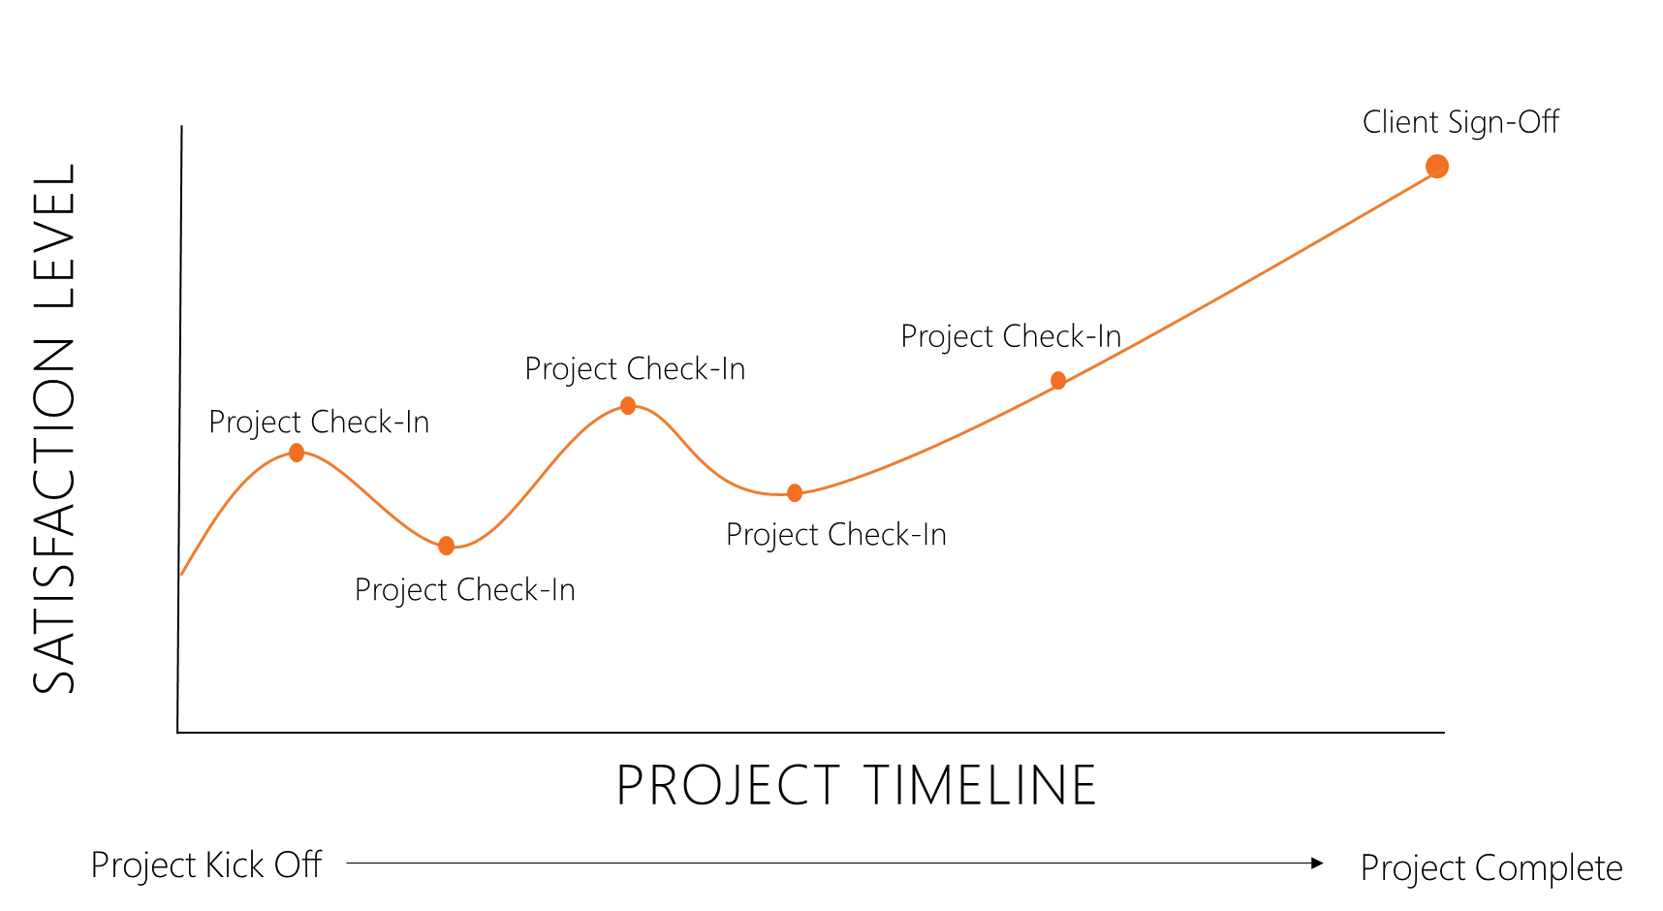
Customer Satisfaction
Customer Experience
Measure of client experience throughout the course of an engagement. This is a data driven metric, gathered every 2-3 weeks by Affirma Account Manager. Any client concerns, even minor points of feedback that arise are flagged and resolved immediately by the responsible General Manager and Practice Lead.
Customer Satisfaction
Measure of client satisfaction at the end of an engagement. This is a data driven metric, gathered by a 3rd party service after the completion of each project.

Slide 7
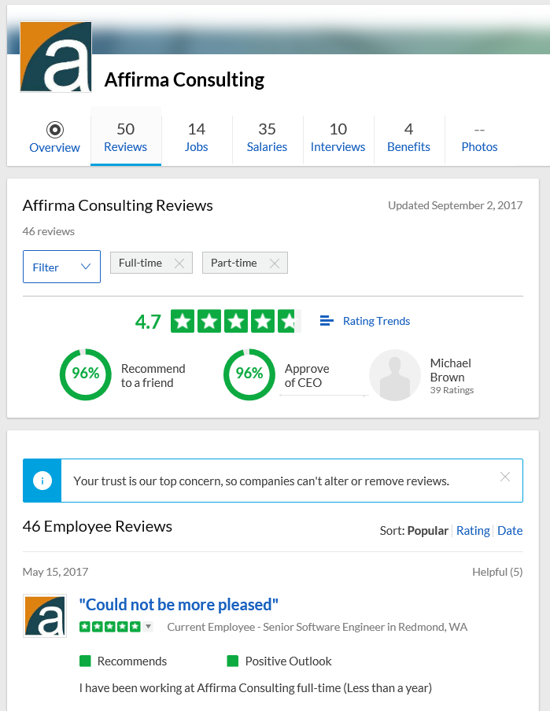


Employee Satisfaction
Employee Satisfaction
Since Affirma started 16 years ago, Employee Satisfaction and Customer Satisfaction have been our top organizational values. Affirma’s leadership team is very diligent in facilitating employee feedback loops through multiple channels to ensure employees are heard and adjustments can be made.
Affirma Awards
Affirma is a 5-time Inc 5000 winner recognizing Americas fastest growing companies. We have recently been ranked #43 in Washington’s top 100 fastest growing private companies. Affirma has been highlighted by the Puget Sound Business Journal four years in a row for being a “Top 100 Fastest Growing Private Company on the Eastside” as well as a “Washington’s Best Places to work.” We have been named Microsoft’s Partner of the Year and Microsoft’s General Manager Award. These awards are a testament to Affirma’s ability to provide impactful solutions to our clients and reflect the company’s exponential growth in both revenue and number of employees.
Check out Affirma on Glassdoor
We strongly encourage you to review Affirma’s Glassdoor ratings, as well as the those of the other vendors involved in this process. You will find that Affirma has industry leading scores in regards to employee feedback, something we are very proud of.

Slide 8
Case Studies

Slide 9

SharePoint
Featured Work

Slide 10

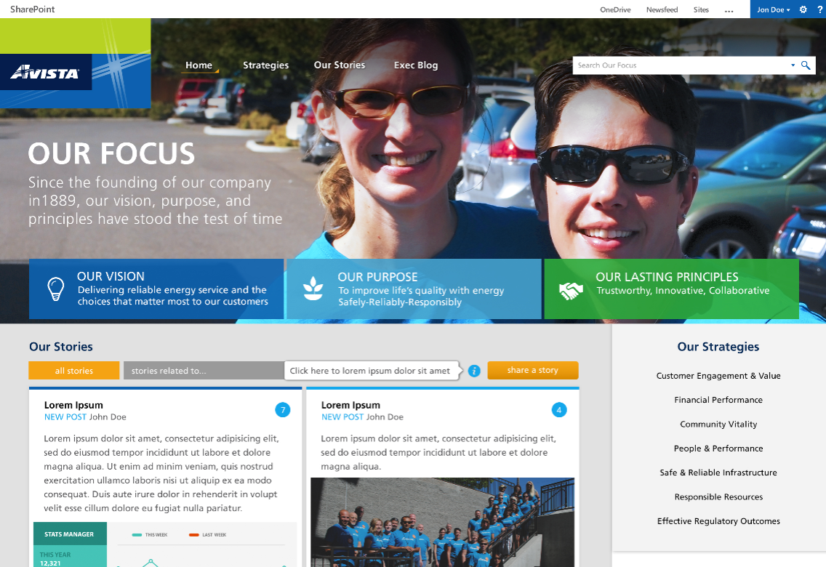
Avista Corporation - Intranet
Who They Are Avista is one of the largest utilities providers in the NW, providing reliable and safe energy services to eastern Washington, Idaho and Oregon since 1889.
Avista is involved in the production, delivery and distribution of energy and energy related businesses.
What Affirma Did
As an off shoot of the larger intranet site engagement, the Executive Leadership team at Avista engaged Affirma to develop a micro-site, “Our Focus”, about the company’s strategies.
Affirma’s challenge was to create an engaging, conversational experience to personalize the strategies to employees’ day-to-day jobs. The site was approved at the board level.
Avista’s “mobile first” commitment to optimize their field employees’ experience, had our team to design and implement a highly responsive design that works with the widest range of device sizes.

Slide 11
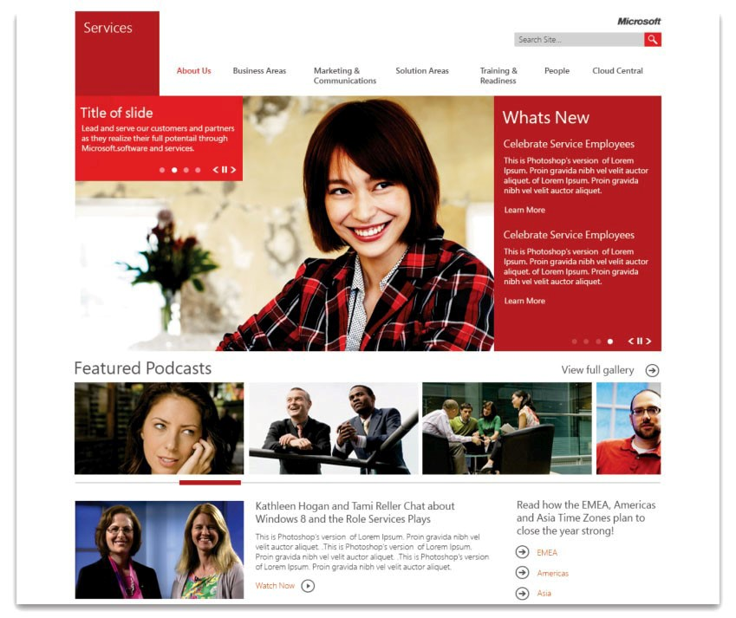
Microsoft Service Division
Business Need
Microsoft Services division approached us with a challenge to architect a semi-customized intranet portal. They requested a custom visual design and several unique workflows which would assist in the automation for several in-house processes however requested Affirma keep closer to an out of the box version of SharePoint.
What We Did Brought in Affirma’s SharePoint subject matter experts to implement custom work flows which automated document processing.
Maintained a degree of standard out of box product with minor adjustments, reducing development time and sustaining pricing level over the entire engagement.
Utilized Affirma’s creative arm, Affirma Studios, to produce visually unique and easy to navigate design.

Slide 12

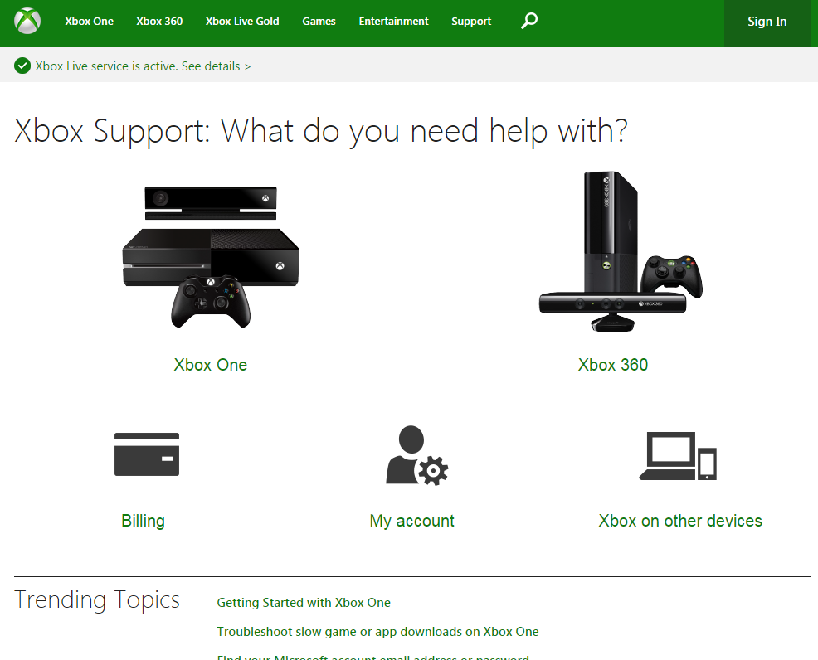
Xbox Customer Support - Migration
Business Need
Support.Xbox.com provides a self-service support platform for customers who are having issues with their consoles, need to update billing information or want to manage their accounts. Microsoft needed to migrate their existing support site from a custom CMS platform to SharePoint in an extremely condensed timeframe.
What We Did
We were engaged to take the existing site design and migrate it into SharePoint in a very compressed project schedule.
We created the new master pages, templates, content types, web parts, and pages necessary for the new site and deployed the application into the production environment.
Support.Xbox.com is now live and localized into over 40 languages. Feedback from users has been largely positive. The project was launched on-time and under budget.

Slide 13
Office365
Featured Work

Slide 14

Zillow Group - Office 365 Implementation
What We Did
Zillow acquired Trulia in the marketplace and needed to merge their companies to share their productivity suite. Due to complexity of IT dependencies, they needed to leverage newer technologies at the time, such as AADSync to support multi-forest configurations. Affirma, as a managed Microsoft Partner, successfully sync’d and migrated Trulia’s email accounts from Intermedia to the Office 365 platform while keeping both forests separate to meet business needs and requirements.
The Result
Zillow was emphatically satisfied with Affirma’s project team and with the final product. In addition to Zillow being overjoyed, Microsoft celebrated Affirma’s ability to navigate this complex deployment. Zillow is still enjoying the advanced capabilities and up-to-date functionality that the Office 365 platform provides. The Zillow team appreciated Affirma’s ability to work within an exact timeline, is thrilled with the successful migration of Trulia’s email accounts and Affirma’s ability to handle the complexities that come with migrating 2,000+ users.

Slide 15

Zonar Systems - O365 Email Migration
What We Did Zonar Systems came to Affirma with a need to upgrade their current ADFS and on premise Exchange 2007. We went through group sessions with Zonar Systems to understand key functionality, implement new technology and upgrade ADFS to 2013 and migrate to Office 365.
Zonar systems was extremely focused on applying forward thinking methods. Utilizing best practices, Affirma accomplished their goal of configuring Office 365 and migrating 900GB of data on exchange with approximately 220 users.
The Result
Zonar was extremely pleased with Affirma’s ability to listen to their needs and help them clean up the architecture of their Active Directory. Affirma was able to upgrade Single Sign on components with ADFS from 2003 to 2012 as well as setup and configure Office 365. Zonar was emphatically satisfied with Affirma’s ability to migrate mailboxes to Office 365, provide documentation to assist with configuring Outlook for end users to connect to O365. Additionally, Affirma provided training for admins on how to manage everything in O365.

Slide 16
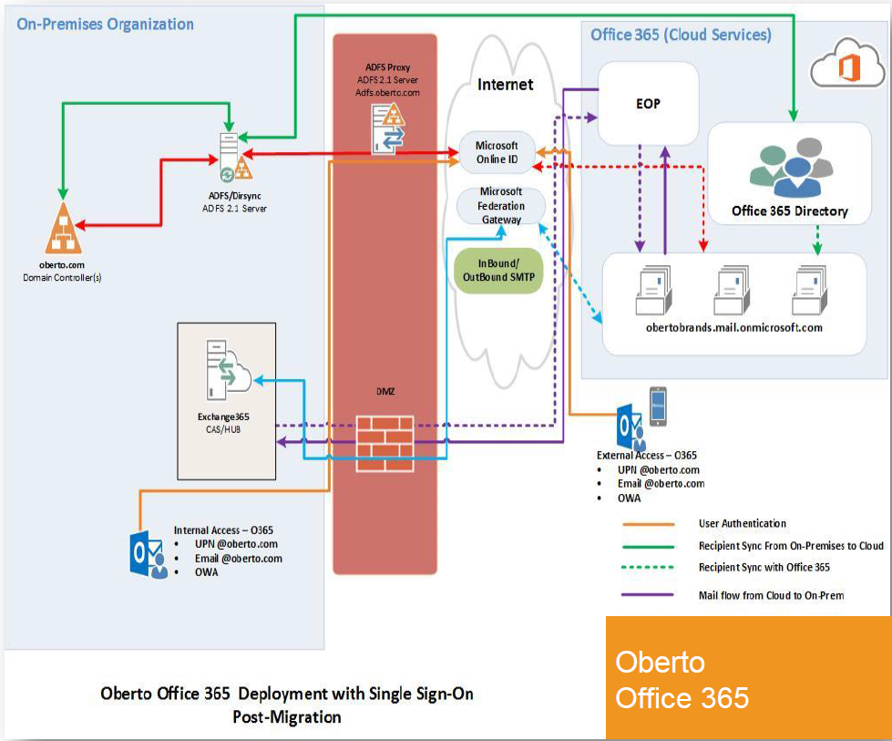

Oberto - Office 365 Migration
Business Need
Oberto, a snack foods company, came to Affirma and with a need to update its aging, low availability, infrastructure to a more modern practice. They had 3 lower capacity on-premises servers with no room for additional growth, yet they as an organization were looking towards growth in the near future. Similarly, they had no Instant Messaging/collaboration tool in place for employee’s to communicate and collaborate with one another. Oberto needed a comprehensive solution which would allow them flexible growth plans, high server availability, and a dynamic instant communication tool for cohesive communication.
What We Did
Moved all users to the cloud for Exchange and Lync, which increased server reliability and user storage capacity from under 1 GB to 50 GB, and deployed login services for a SSO experience.
Results
All existing users across the organization were moved to Office 365’s flexible cloud based solution, increasing availability and storage for users. Similarly, the added function of Lync addressed the need for an collaboration and instant messaging tool. Oberto is currently in the process of growing and will be able to easily add new users and content to fit their needs.

Slide 17
Business Intelligence
Featured Work

Slide 18
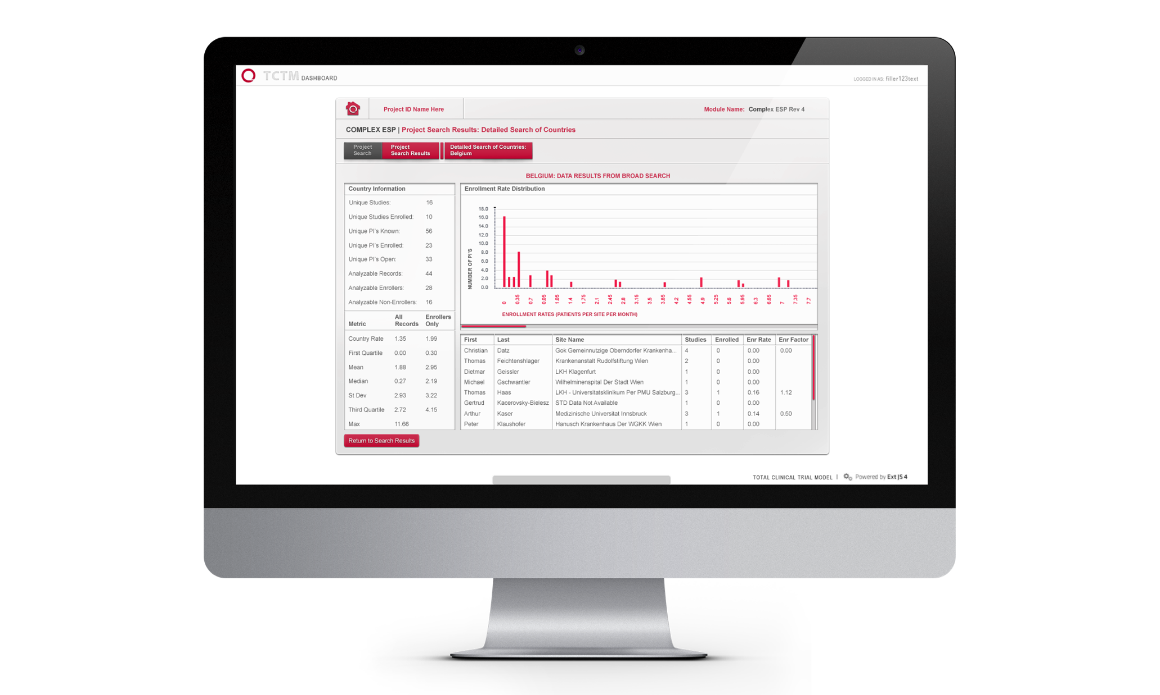
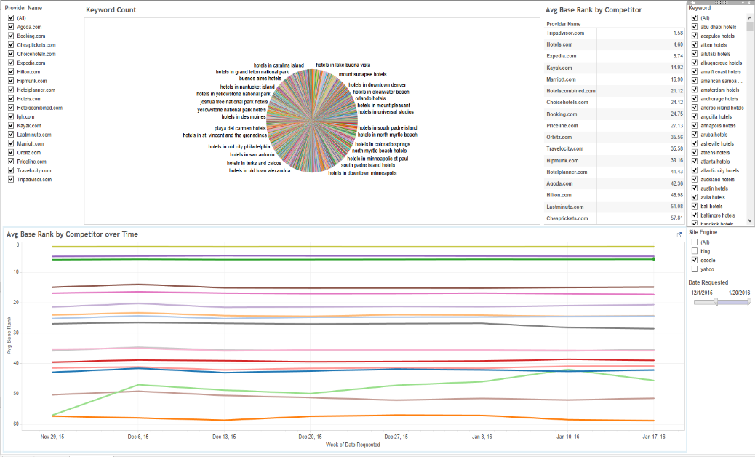
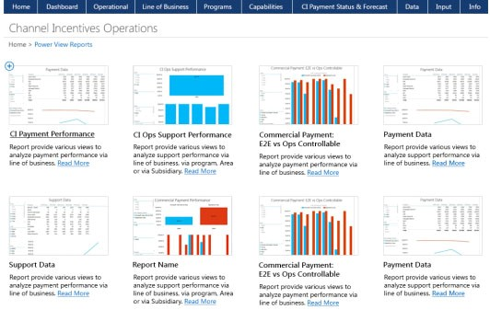
Expedia - SEO Analytics
Business Need
Expedia’s Search Engine Optimization (SEO) Department needed an easy yet powerful way to analyze millions of search result data points. Every day, more than 100 million search results needed to be analyzed to identify trends and opportunities to modify SEO on the top search engine web sites. The solution needed to be fast and scalable, given the amount of data to be aggregated. Expedia also requested a recommendation for determining which BI tool would meet the business needs.
What We Did
Utilizing Azure Data Warehouse, SQL Server Integration Services, Tableau and Power BI, Affirma developed a semi-autonomous process for importing the data and visualizing the data.
Performance benchmarking was conducted between Power BI and Tableau; as well as feature comparisons.
Without leaving the simple, intuitive dashboard interface, users can: access millions of data points for a single day or a custom timeframe, display powerful visuals, identify the trends and impact of keyword configurations, and generate results to support high-impact business units.

Slide 19
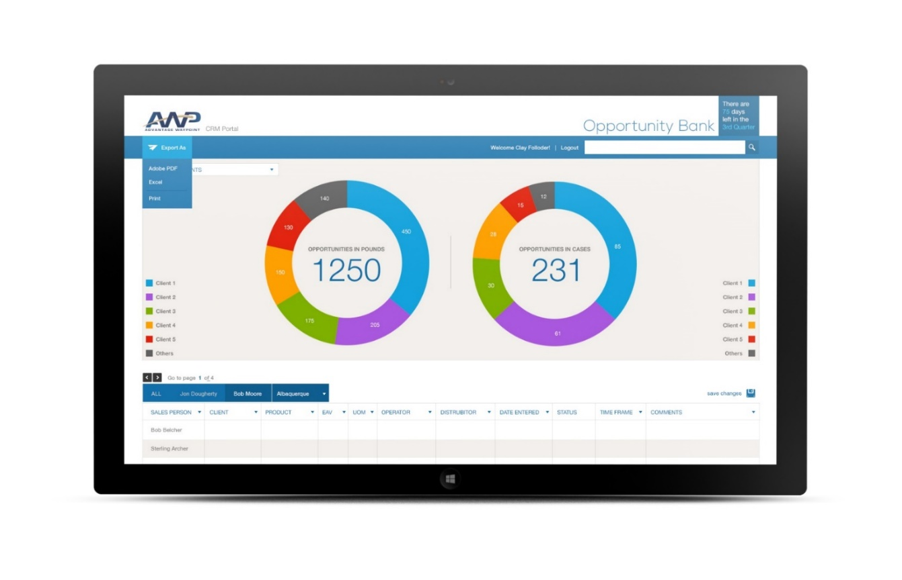
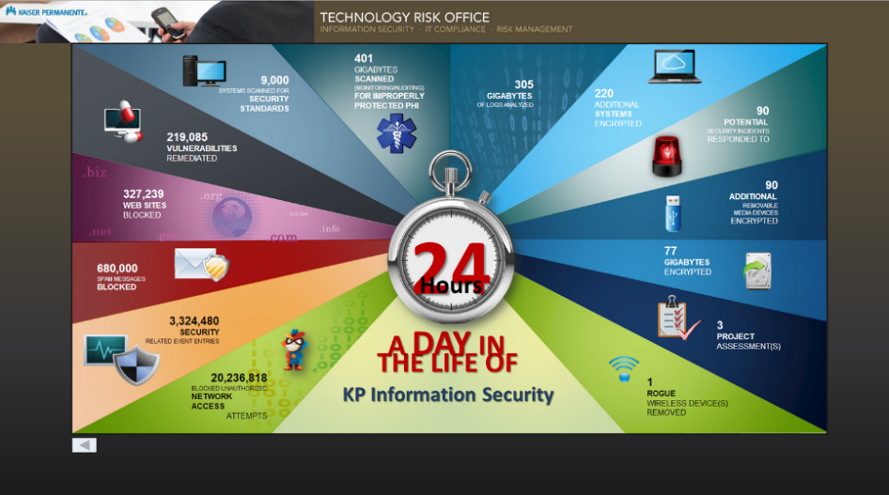


Kaiser Permanente - Data Mart
Business Need
Kaiser Permanente, one of the nation's largest managed health care firms, needed to implement data security measures under the Health and Information Trust Alliance (HITRUST). HITRUST is a certification framework that is used by organizations to securely create, access, store and exchange personal health and financial information. Affirma was contracted to convert Kaiser’s prototype data security platform into a fully-functional Data mart solution that could monitor all of the organization’s highly sensitive data.
What We Did
Affirma converted a prototype of the data-feed to a complete and fully functional .NET/SQL solution
Created a lightning-fast digital read-out that allows users to identify any spikes in security issues quickly and easily.
Built a dynamic user interface so that users of the Data mart solution have up-to-date information to use when monitoring and tracking their systems.
Kaiser Permanente was very pleased with the Data mart solution. Kaiser now has the ability to easily identify and monitor any security issues in their system, ranging from unauthorized network access attempts to improperly protected health information and blocked spam messages.

Slide 20
Managed Services
Featured Work

Slide 21
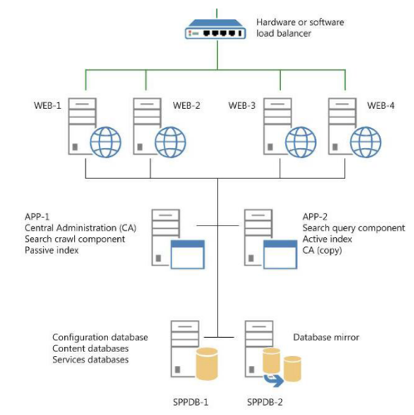

Snap-On - Managed Services
Business Need
Snap-On is a leading global developer, manufacturer and marketer of tool and equipment solutions for professional tool users. Snap-On has more than 22,000 products, operates in more than 130 countries and employs approximately 11,000 people worldwide. They also have a franchise network of more than 4,200 franchises. After working unsuccessfully with a separate vendor on their collaboration platform, Snap-on engaged with Affirma. It became apparent they were not receiving a consultative approach to the platform as well as ongoing oversight and support.
What We Did
Affirma evaluated their existing SharePoint environment and delivered findings and recommendations. We proposed an ongoing support engagement model that better met their long-term goals and strategy around collaboration.
Results
We delivered a managed collaboration platform meeting core business requirements. Overseeing their environment ongoing allows them to focus on their business while ensuring their business-critical collaboration platform is running and meeting the business needs.

Slide 22

Microsoft - ISS SharePoint Management
Business Need
Microsoft’s Internet Security Services (ISS) team partnered with Affirma to manage and update their rapidly growing SharePoint site collections used by the Xbox engineering team. We took over management of re-architecture, custom design, content migration, site planning, end-user support and training for over 6,500 users.
What We Did
Managed existing SharePoint site collection and segmented the portal into 10 site collections, implementing new architecture and migrating their content to allow for the exponential growth the team was experiencing.
Created custom master page designs and page layouts for multiple teams.
Provided day-to-day support managing permissions, auditing site growth and answering requests from site owners and users.
Updated navigation and architecture based on organizational changes, including configuring new site collections and migrating content into non-ISS environments for transfer to new owners.
We brought a new level of service to the client for managing the centralized internal portal for all things Consumer and Online at Microsoft.

Slide 23

Stonehenge Capital - 24/7 Support
Business Need
Stonehenge Capital deployed Office 365 and needed a 24/7 IT support solution for all of their users.
What We Did
Affirma set up a 24/7 Help Desk Support engagement to meet all of Stonehenge’s needs.
All IT tickets are handled via phone, email and IM chat.
Provided a 3 Tier support team, including Tier 1 Support Technicians, Tier 2 Support Engineers and Tier 3 Office 365 Architects.

Slide 24
Thank You

